Slide 1
Microsoft Azure/ Visual Studio Roadshow
Dan Fluet
Cloud Practice Director
Stephen Kimble
Senior Azure Consultant

Slide 2
Agenda
Introduction &
Service Fabric
Event Hub & Stream Analytics
Component Integration
Notes:
Discuss agenda

Slide 3
Introduction & Service Fabric
Notes:
Talk about questions
https://github.com/kimblesa/tallan-service-fabric-roadshow
Quickly discuss service fabric

Slide 4
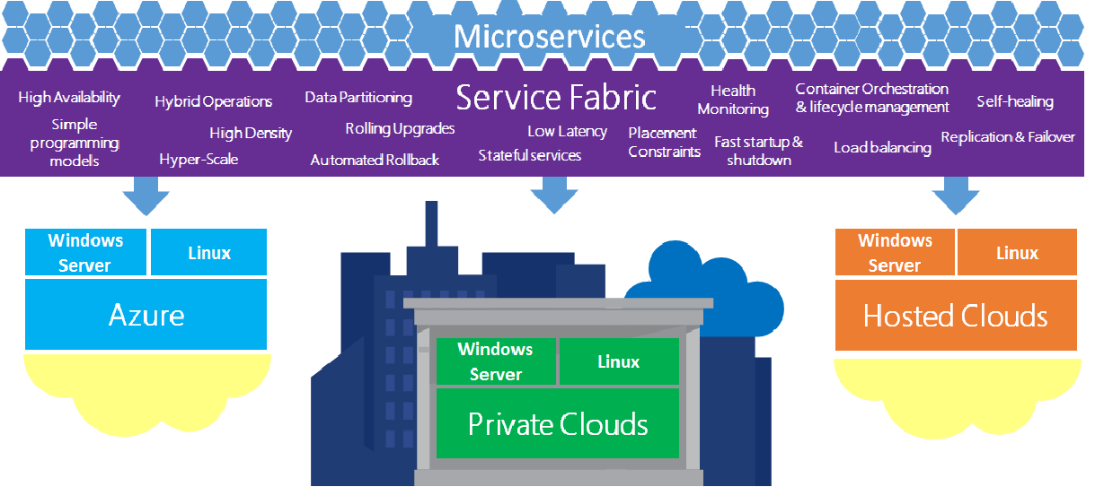
Setting the stage
Microsoft Azure
Azure App Services
.NET Core

Slide 5
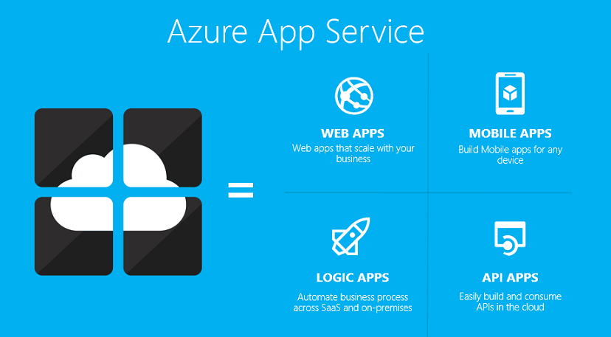
Azure App Services
Platform-as-a-Service
Azure Websites and Mobile Services, expanded
App service plans
Notes:
PaaS
App Service plans define:
Region (West US, East US, etc.)
Scale count (one, two, three instances, etc.)
Instance size (Small, Medium, Large)
SKU (Free, Shared, Basic, Standard, Premium)
TALK SLOW

Slide 6
.NET Core
“There are only two hard things in Computer Science: cache invalidation and naming things.” - Phil Karlton
.NET Core 2.0; ASP.NET Core 2.0; Entity Framework Core 2.0
Rebuilt from ground up for cross-platform
Replaces .NET 4.6, still in active development
Notes:
So a quick primer on .NET Core – it’s the latest and greatest from Microsoft and the path for new development moving forward
I shamelessly ripped that quote from Scott Hanselman’s blog announcing .NET Core
.NET Core replaces .NET 5, ASP.NET Core replaces ASP.NET 5
.NET 4.6 still exists and has more functionality and is more stable than Core, but you can expect the functionality and stability gap to narrow over time
Cross-Platform: the .NET runtime runs on many different platforms – RedHat, Ubuntu, etc
Rebuilt for scalability, better support for dependency injection

Slide 7
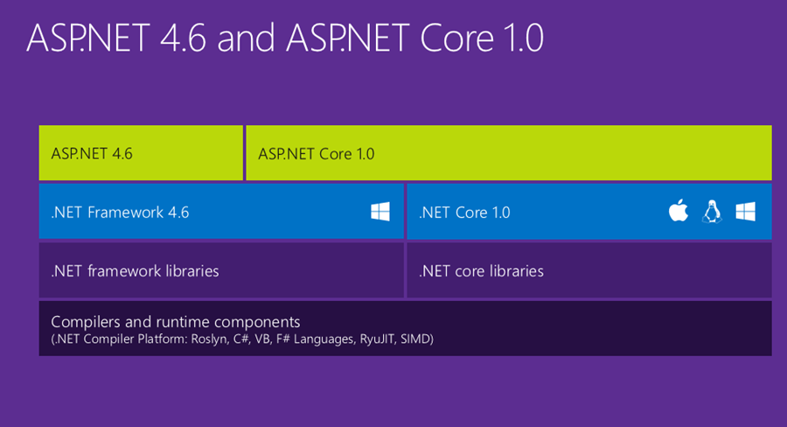
.NET Core

Slide 8
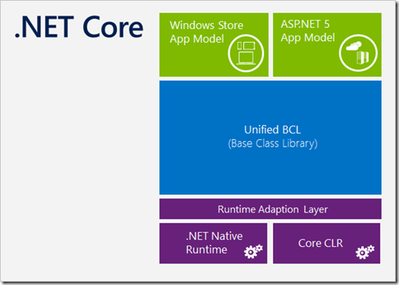
.NET Core 2.0
Open-source, cross-platform
Built for scalability, flexibility
Modular – NuGet is front and center
Notes:
Rebuilt for scalability, better support for dependency injection
Why? Because it’s modular – your version of the runtime is different than the one running on a server hosted in Azure – NuGet is front and center in adding packages to your version of the .NET core platform.
TALK SLOW

Slide 9
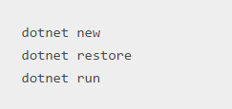
.NET Core 2.0
Strong command line support
Easy to make a project
Notes:
So what does that all mean? Dotnet core is easy to use --
dotnet new – makes new project.json, defines version, framework information, and dependencies; makes a hello world program in Program.cs
dotnet restore – pull down NuGet packages based on dependencies defined in project.json
dotnet run – compiles and runs the project
Do quick demo of creating a project
Making new .net core project from command line is pretty simple as well
Can use Visual Studio Community or VS Code (cross-platform editor, written in typescript)
TALK SLOW

Slide 10
.NET Core 2.0
Demo
Notes:
So what does that all mean? Dotnet core is easy to use --
dotnet new – makes new project.json, defines version, framework information, and dependencies; makes a hello world program in Program.cs
dotnet restore – pull down NuGet packages based on dependencies defined in project.json
dotnet run – compiles and runs the project
Do quick demo of creating a project
Making new .net core project from command line is pretty simple as well
Can use Visual Studio Community or VS Code (cross-platform editor, written in typescript)
TALK SLOW

Slide 11
What’s new with 2.0?
.NET Standard (2.0) standards increases compatibility
Doubled API counts (from 13k to 32k) in .NET Core
.NET Core 2.0 Works on most Debian and Red Hat-based Linux distros
Can reference .NET Framework libraries from .NET Standard
Notes:
More versions of .NET are able to implement .NET Standard
(formal spec of .NET API’s that must be defined for any implementations of .NET)
(supported by .NET Framework 4.6.1, .NET Core 2.0, Mono, Xamarin, UWP is coming)
API counts are mainly to increase compatibility with .NET 4.6, and ensuring that .NET Framework dependencies in NuGet can migrate into .NET Standard

Slide 12
ASP.NET Core 2.0
First-class support for Dependency Injection
Goodbye, IIS; hello, OWIN (Kestrel web server)
ASP.NET Core 1.1 with Kestrel is one of the fastest mainstream full-stack web frameworks
Notes:
.NET Core replaces .NET 5, ASP.NET Core replaces ASP.NET 5
.NET 4.6 still exists and has more functionality and is more stable than Core, but you can expect the functionality and stability gap to narrow over time
IIS is no more; OWIN (Open Web Interface for .NET) is used now, with Microsoft’s implementation called Katana

Slide 13
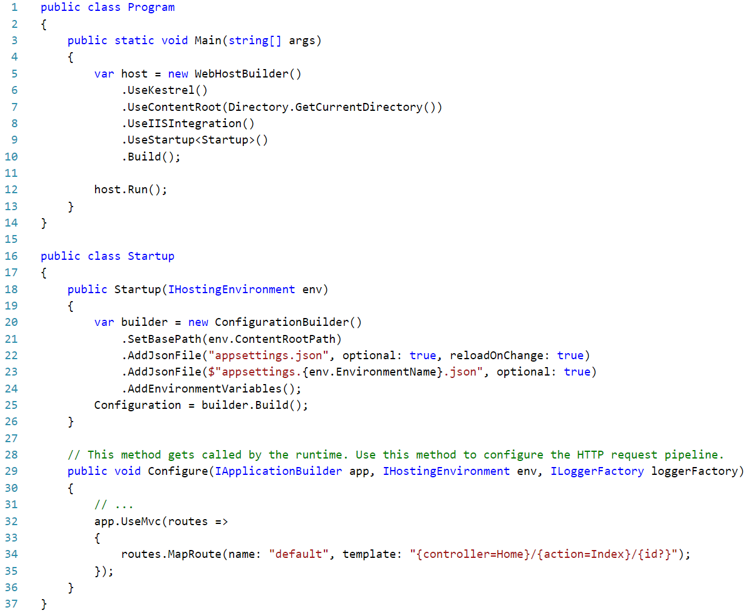
ASP.NET Core 2.0
Notes:
.NET Core replaces .NET 5, ASP.NET Core replaces ASP.NET 5
.NET 4.6 still exists and has more functionality and is more stable than Core, but you can expect the functionality and stability gap to narrow over time
IIS is no more; OWIN (Open Web Interface for .NET) is used now, with Microsoft’s implementation called Katana

Slide 14
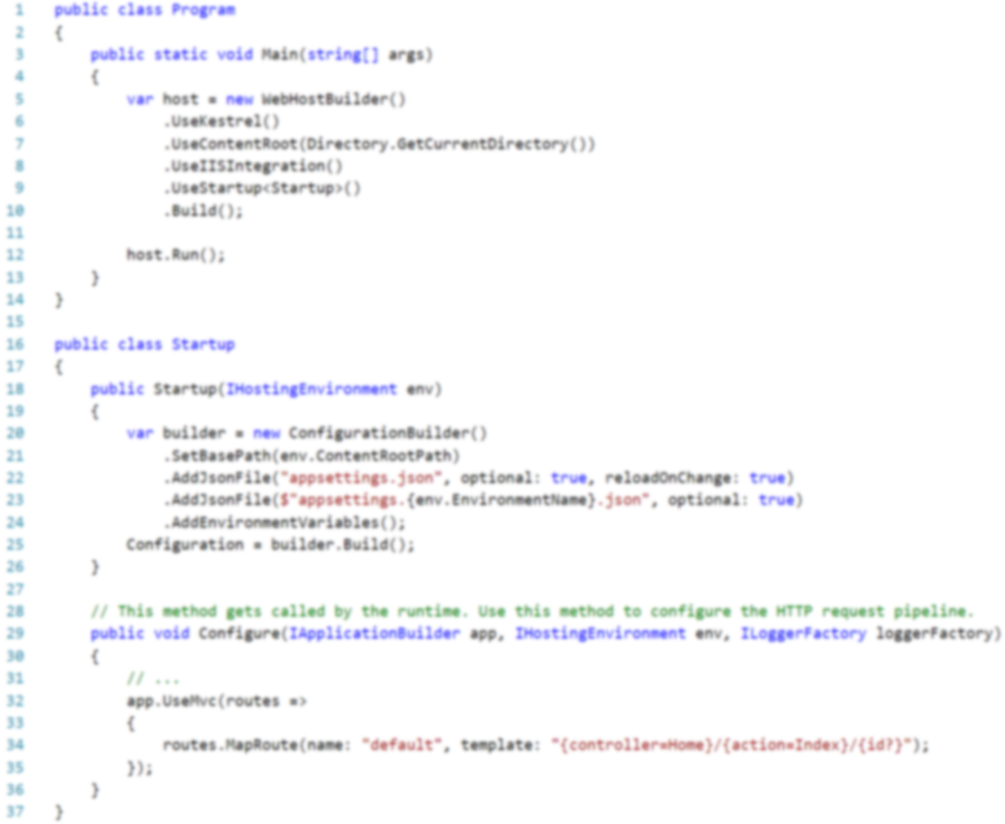
ASP.NET Core 2.0
Notes:
.NET Core replaces .NET 5, ASP.NET Core replaces ASP.NET 5
.NET 4.6 still exists and has more functionality and is more stable than Core, but you can expect the functionality and stability gap to narrow over time
IIS is no more; OWIN (Open Web Interface for .NET) is used now, with Microsoft’s implementation called Katana

Slide 15
ASP.NET Core 2.0
Notes:
.NET Core replaces .NET 5, ASP.NET Core replaces ASP.NET 5
.NET 4.6 still exists and has more functionality and is more stable than Core, but you can expect the functionality and stability gap to narrow over time
IIS is no more; OWIN (Open Web Interface for .NET) is used now, with Microsoft’s implementation called Katana

Slide 16
EF Core 2.0
.

Slide 17
What is Azure Service Fabric?
Microservice-based application development
Low-latency, massive scale
Decompose app into small, independent services
Used broadly for existing Azure offerings
Notes:
So it’s microservice-based development. Instead of having one monolithic service, even one hosted in an Azure WebApp, it provides a framework for automatically handling large numbers of virtual containers of various types.
[Define a microservice; write on the board what it entails, talk about resource sharing] The basic idea here is that you have a cluster of virtual machines running the Service Fabric runtime. They all combine to provide an available pool of resources, and each microservice, compartmentalized as a virtual container, draws from that pool of resources for the duration that it’s needed.
I spun up a cluster in Azure that uses 5 virtual machines, but you can create a much larger cluster, with potentially dozens of high-power VM’s, providing a huge amount of scalability and especially resiliency.
It’s definitely telling that Microsoft is really eating their own dog food here; Service fabric is already used for a lot of their existing offerings, like DocumentDB, Azure SQL, Skype for Business, and quite a few more.
TALK SLOW

Slide 18
What is Service Fabric Used For?
Eat your own dogfood
Azure SQL Database; DocumentDB, Power BI, Event Hubs, etc.
Think containers, not Virtual Machines (hyperscale)
High performance and reliability, scalability

Slide 19
Service Fabric Anywhere
Notes:
So, what’s the idea of Service Fabric? To be able to effectively compartmentalize different components of a complex application, so each isolated component can scale independently.
Service fabric provides a wealth of features built-in and abstracted away from the developer to allow for all of the things you see in this diagram.
Better still, you can host service fabric on-prem, on windows or linux servers, or in the cloud. When you run it locally and debug on your machine, the local cluster that is installed and run is the same runtime that runs up in Azure.

Slide 20
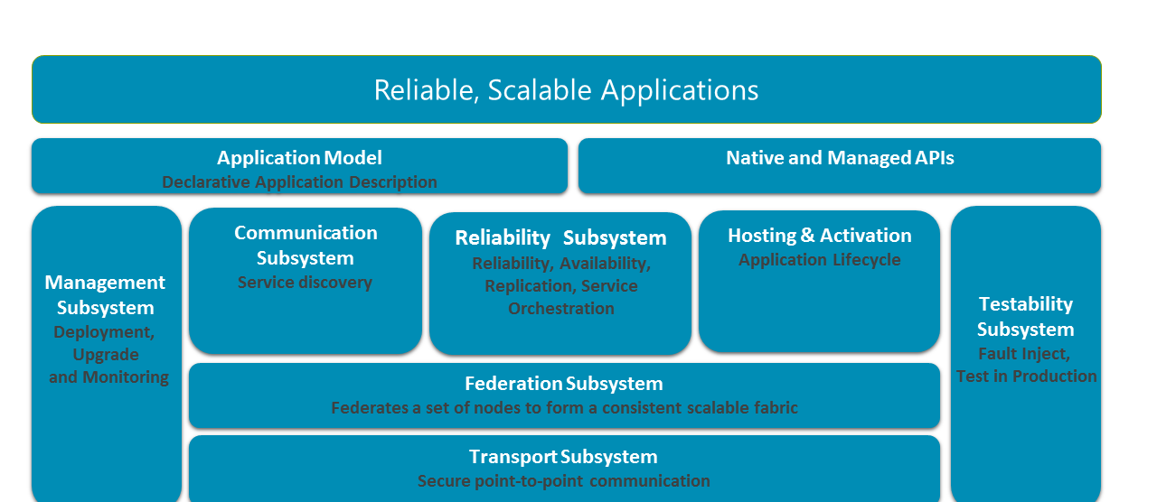
Service Fabric Anywhere
Notes:
So, what’s the idea of Service Fabric? To be able to effectively compartmentalize different components of a complex application, so each isolated component can scale independently.
Service fabric provides a wealth of features built-in and abstracted away from the developer to allow for all of the things you see in this diagram.
Better still, you can host service fabric on-prem, on windows or linux servers, or in the cloud. When you run it locally and debug on your machine, the local cluster that is installed and run is the same runtime that runs up in Azure.

Slide 21


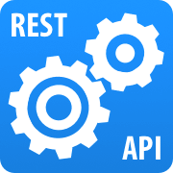
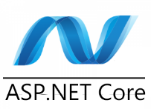
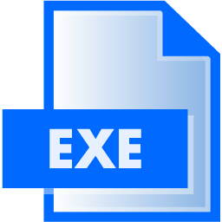
What Can You Build?
All supported within Service Fabric
Reliable Actors
Stateless/Stateful Reliable Services
.NET WEB API
Web Applications
Guest Executable
Notes:
High-level – what would you use Stateless/stateful services for? Or a Reliable Actor? Talk about examples – where are they used in the industry? Good place to talk about or uses, or how the Halo 5 servers use reliable actor pattern.
Mention Java!

Slide 22
Reliable Services
Containers
Reliable
Available
Scalable
Consistent
Stateless or Stateful
Notes:
Reliable – service stays up even with sub-optimal conditions, because the Service Fabric runtime handles fault tolerance, bringing up and down services, etc
Available – the Service Fabric runtime guarantees a degree of availability, due to multiple nodes being available.
Scalable – services are decoupled from hardware, and can be grown or shrunk as necessary – they’re easily partitioned to respond to demand and independently scale and respond to demand
Consistent – Stateful service storage is guaranteed to be consistent
Stateless vs Stateful – main difference is that Stateful has state available to it in the form of reliable collections – persisted across all instances of the service, because it’s transaction-based – I’ll show some code demonstrating that later

Slide 23
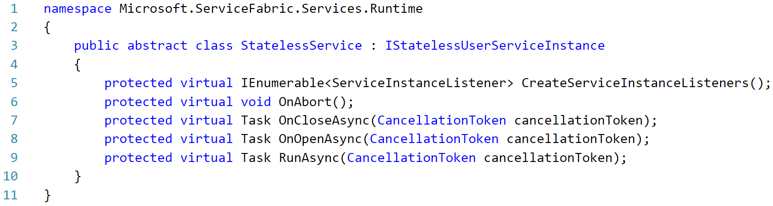
Reliable Services
Containers

Slide 24
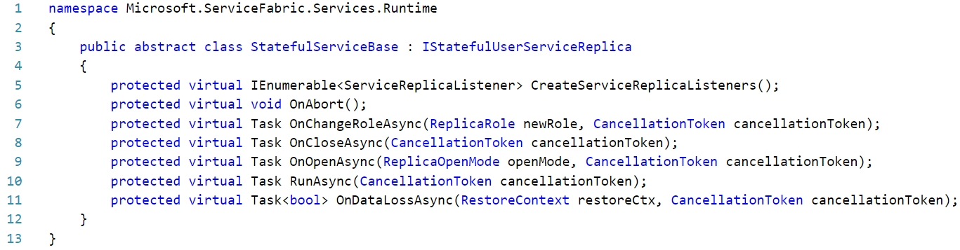
Reliable Services
Containers

Slide 25
Reliable Actors
Isolated Unit of Work
Abstraction over stateful Reliable Service
Virtual Actor design pattern – Orleans
1000’s+ units independent scale
Virtual, not hardware
Automatic garbage-collection
Notes:
Abstraction over Reliable Services – most things hosted in Service fabric can be broken down into one of those two services
If you deploy a Web API, it’s created in service fabric as a stateless reliable service. Reliable Actors are stateful
Look up Orleans – code is on GitHub
Pattern is used for Halo 5 servers
Talk about how actors are started and garbage-collected virtually – when one stays inactive it’s closed down; when a new one is needed, one is started

Slide 26
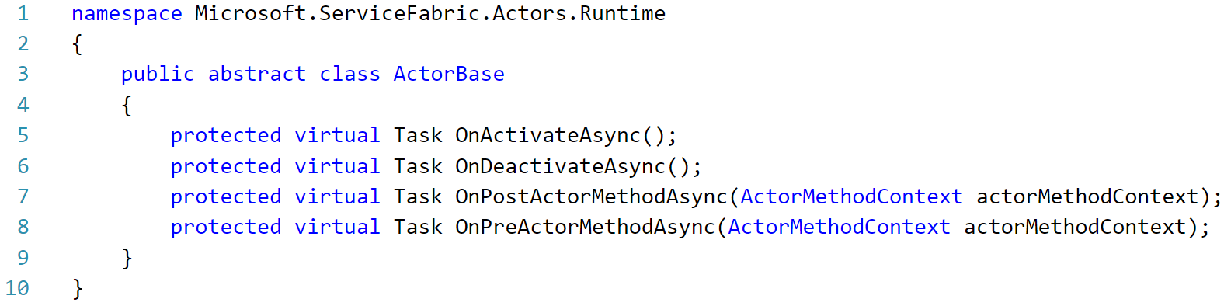
Reliable Actors
Isolated Compute Units
Notes:
Abstraction over Reliable Services – most things hosted in Service fabric can be broken down into one of those two services
If you deploy a Web API, it’s created in service fabric as a stateless reliable service. Reliable Actors are stateful
Look up Orleans – code is on GitHub
Pattern is used for Halo 5 servers
Talk about how actors are started and garbage-collected virtually – when one stays inactive it’s closed down; when a new one is needed, one is started

Slide 27
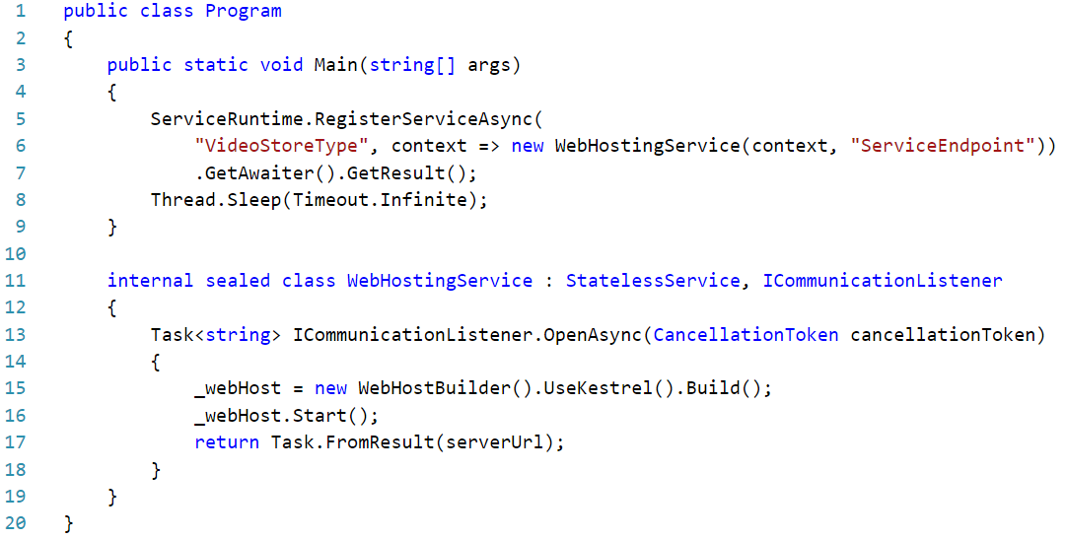
ASP.NET Core Web App
Notes:
Abstraction over Reliable Services – most things hosted in Service fabric can be broken down into one of those two services
If you deploy a Web API, it’s created in service fabric as a stateless reliable service. Reliable Actors are stateful
Look up Orleans – code is on GitHub
Pattern is used for Halo 5 servers
Talk about how actors are started and garbage-collected virtually – when one stays inactive it’s closed down; when a new one is needed, one is started

Slide 28
Demo
Create new Service Fabric
Notes:
Refer back to the diagram

Slide 29
Service Fabric Implementation
How to think about Service Fabric
Enforce loose coupling of services
Identify different requirements for scale
Identify dependencies, performance bottlenecks
How to implement a store?
Notes:
Diagramming – implementation of Video Store, components that are needed, how they fit together

Slide 31
Service Bus Partitioning
Group information based on the data received
Service fabric auto-balances
Ideal for Stateful services
Not normally required for Stateless

Slide 32
Demo
Sample Implementation of a Video Store in Service Fabric
Web API, Reliable Service, Actor, .NET Core Web App
1000 foot view of Service Fabric
Notes:
Refer back to the diagram

Slide 33
Questions?
Tallan Contacts:
Dan Fluet
Cloud Practice Director
dan.fluet@tallan.com

Slide 34
Lunch

Slide 35
Event Hub & Stream Analytics

Slide 36
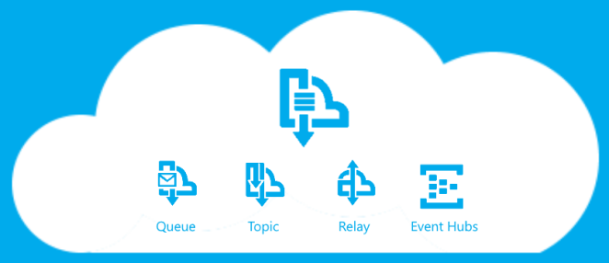
Azure Service Bus

Slide 37
Azure Service Bus
Asynchronous messaging
Decouple applications from each other
Multiple apps with a single secure connection (Relay)
Queues, Topics, Event Hub

Slide 38
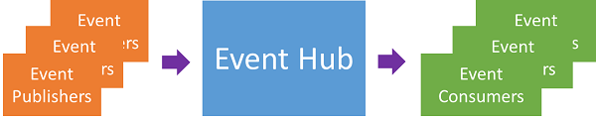
Event Hubs
Ingest 1,000,000’s of messages
Message stream handling
Similar to Service Bus queues/topics, writ large
Emphasize high throughput, event processing
Supports HTTP, AMQP

Slide 39
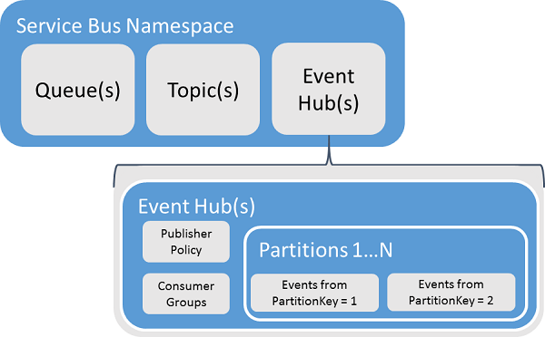
Event Hubs
Partitioned Consumers
Each partition holds events for set time
Event Publisher publishes events from hub
Notes:
Output from event hub supports HTTPS/AMQP
Talk about Shared Access Signatures

Slide 40
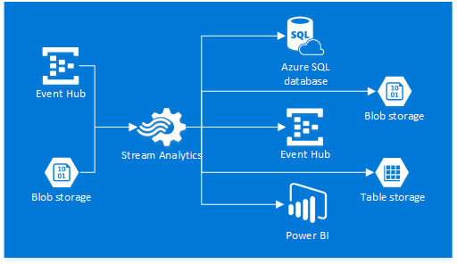
Stream Analytics

Slide 41
Stream Analytics
Identify patterns in large data on the fly
Ingest large amounts of data in a stream
Query data on the fly
Data in from Event Hub, etc
Output to Azure storage, HDInsight, etc

Slide 42
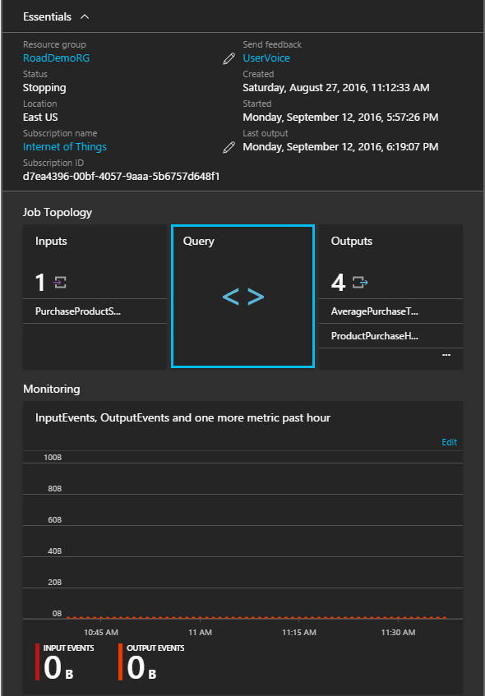
Connect Stream Analytics
Notes:
Inputs from Event Hub, IOT Hub (quickly talk about differences), local storage
Outputs to SQL, event hub, service bus, Data Lake, etc

Slide 43
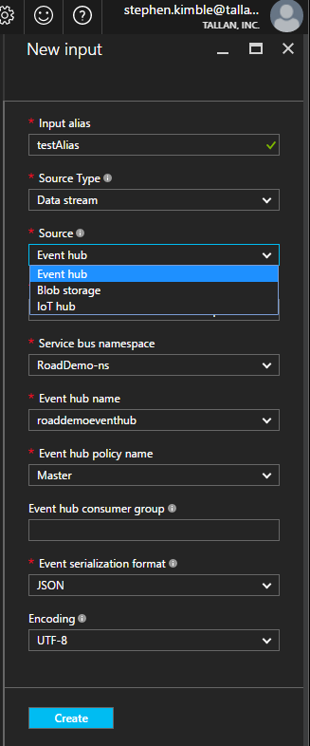
Connect Stream Analytics
Notes:
Inputs from Event Hub, IOT Hub (quickly talk about differences), local storage
Outputs to SQL, event hub, service bus, Data Lake, etc

Slide 44
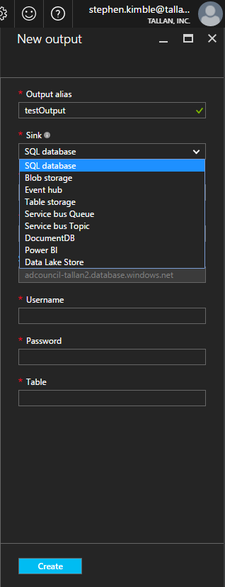
Connect Stream Analytics
Notes:
Inputs from Event Hub, IOT Hub (quickly talk about differences), local storage
Outputs to SQL, event hub, service bus, Data Lake, etc

Slide 45
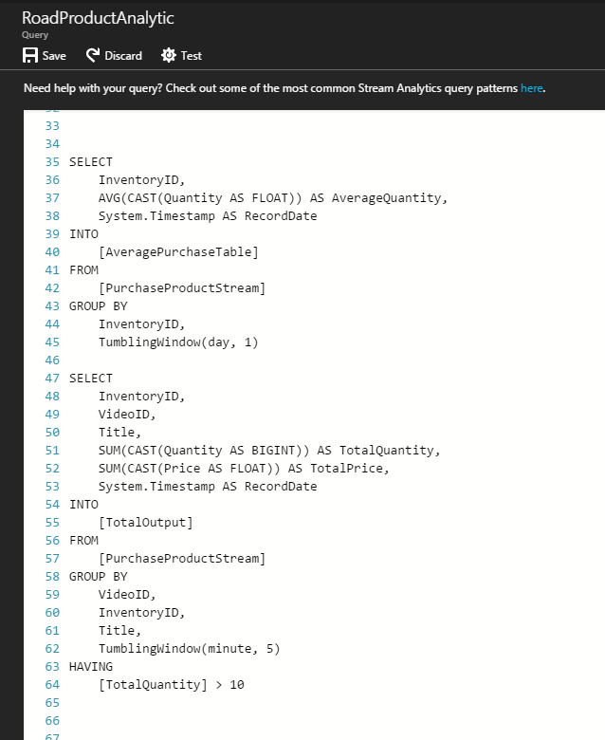
Write Queries
SQL-like syntax
Windowing on select timeframes
Conditional processing

Slide 46
Integrate with other Apps?
Link applications to an event hub to publish events
Service Fabric: Reliable Actors
Stream Analytics takes data from Event Hub
Conditional processing, output to different storage

Slide 47
Demo
Create Event Hub, linked to Service Fabric app
Create Stream Analytics job -- linked to Event Hub, storage account
Write queries against data
Notes:
Practical usage – what we’ve done in the past – fingerprint POC, Fielding systems, etc

Slide 48
Questions?
Tallan Contacts:
Dan Fluet
Cloud Practice Director
dan.fluet@tallan.com

Slide 49
Component Integration

Slide 50
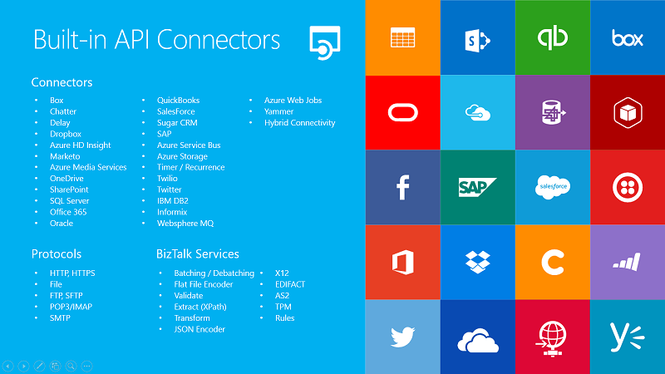
Logic Apps

Slide 51
Logic Apps
Scalable Orchestrations in the Cloud
Create orchestrations with conditional logic
Dozens of built-in connectors
First-class support for Service Bus, API Management, other Azure offerings

Slide 52
Logic Apps
Easy UI for creating orchestrations
Graphical Interface and Code View
Trigger-based inputs from other services
Loops, Conditions, easy transformation of data
Notes:
Talk about the bullet points
Configuration first
Microsoft Flow also built on top of Logic Apps

Slide 53
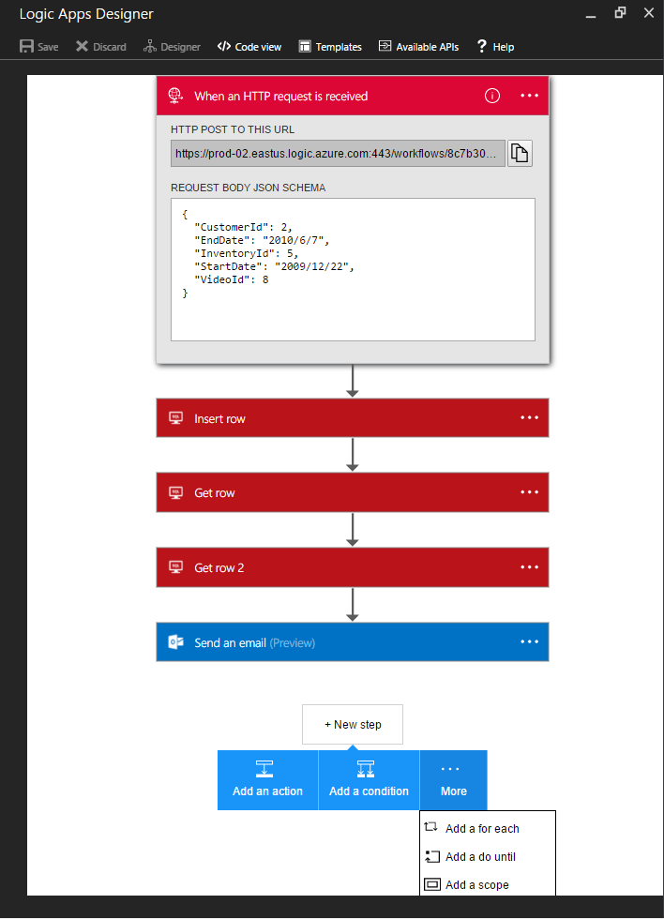
Logic Apps
Easy UI for creating orchestrations
Graphical Interface and Code View
Trigger-based inputs from other services
Loops, Conditions, easy transformation of data

Slide 54
WebJobs
Scalable Orchestrations in the Cloud
Deploy applications to run alongside your apps
Run alongside Azure App Services
WebJobs SDK
Notes:
Run continuous, on demand, or scheduled
Supported:
.cmd, .bat, .exe (using windows cmd); .ps1 (using powershell); .sh (using bash); .php (using php); .py (using python); .js (using node); .jar (using java)
SDK hooks into Azure elements like Azure Storage and Service Bugs
Binds to C# primitives like Stream, string, etc
Allows for remote debugging

Slide 55
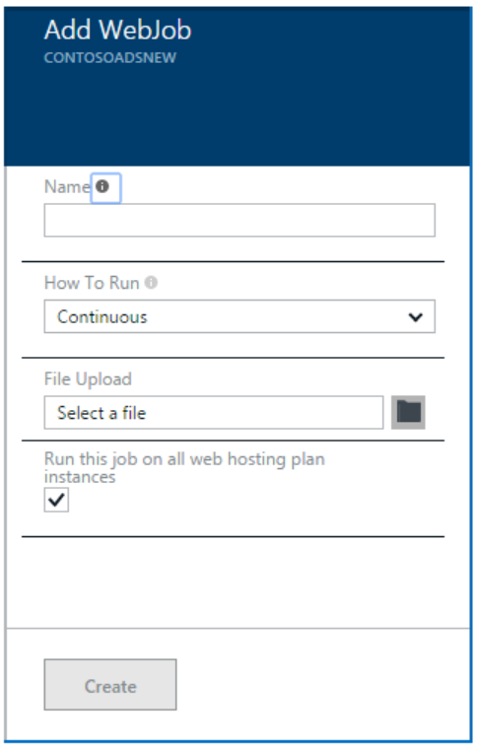
WebJobs
Scalable Orchestrations in the Cloud
Deploy applications to run alongside your apps
Run alongside Azure App Services
WebJobs SDK
Notes:
Run continuous, on demand, or scheduled
Supported:
.cmd, .bat, .exe (using windows cmd); .ps1 (using powershell); .sh (using bash); .php (using php); .py (using python); .js (using node); .jar (using java)
SDK hooks into Azure elements like Azure Storage and Service Bugs
Binds to C# primitives like Stream, string, etc
Allows for remote debugging

Slide 56
Azure Functions
Scalable Orchestrations in the Cloud
Similar to WebJobs, but with more flexibility
Can use C#, Python, Node.js, etc
developed in the Azure portal or deployed from source control
Pay-per-use
Notes:
Similar to Logic Apps, running within the aegis of App Services
Logic Apps are configuration-first – good for building orchestrations with other services, workflows, etc (Microsoft Flow is built on top of Logic Apps, is more user-friendly, don't need developer support)
Functions is code first – you write and deploy code to Azure App Services, which runs it on-demand (Functions are an evolution on WebJobs and improve upon them)
Functions support many different languages and technologies – NuGet and NPM are supported
Pay-per-use – can either pay dynamically, or include them on an existing App Service plan for little to no extra cost.Even the dynamic pricing grants you a million executions free per month.

Slide 57
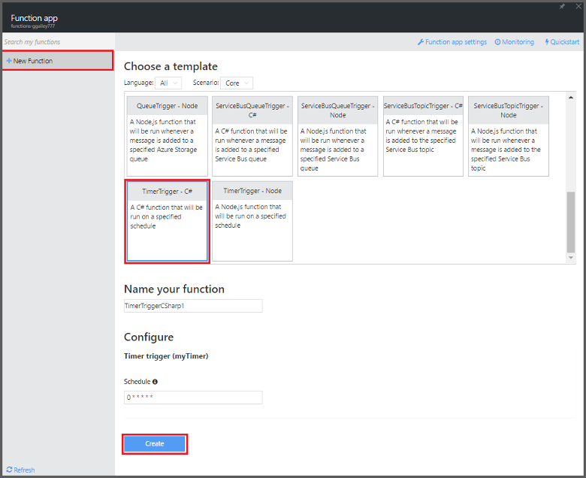
Azure Functions
Scalable Orchestrations in the Cloud
Similar to Logic Apps, but with more flexibility
Can use C#, Python, Node.js, etc
Pay-per-use
Notes:
Similar to Logic Apps, running within the aegis of App Services
Logic Apps are configuration-first – good for building orchestrations with other services, workflows, etc (Microsoft Flow is built on top of Logic Apps, is more user-friendly, don't need developer support)
Functions is code first – you write and deploy code to Azure App Services, which runs it on-demand (Functions are an evolution on WebJobs and improve upon them)
Functions support many different languages and technologies – NuGet and NPM are supported
Pay-per-use – can either pay dynamically, or include them on an existing App Service plan for little to no extra cost.Even the dynamic pricing grants you a million executions free per month.

Slide 58
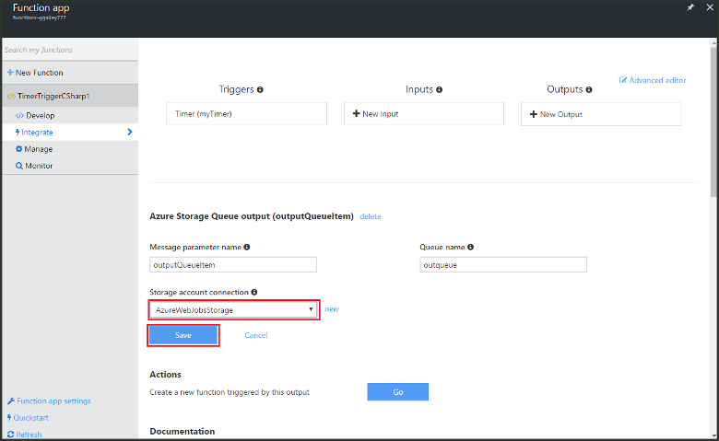
Azure Functions
Scalable Orchestrations in the Cloud
Similar to Logic Apps, but with more flexibility
Can use C#, Python, Node.js, etc
Pay-per-use
Notes:
Similar to Logic Apps, running within the aegis of App Services
Logic Apps are configuration-first – good for building orchestrations with other services, workflows, etc (Microsoft Flow is built on top of Logic Apps, is more user-friendly, don't need developer support)
Functions is code first – you write and deploy code to Azure App Services, which runs it on-demand (Functions are an evolution on WebJobs and improve upon them)
Functions support many different languages and technologies – NuGet and NPM are supported
Pay-per-use – can either pay dynamically, or include them on an existing App Service plan for little to no extra cost.Even the dynamic pricing grants you a million executions free per month.

Slide 59
Compare/Contrast
Confused Yet?
 | Logic Apps | Azure Functions | WebJobs
 | Standalone, orchestration component | Standalone, code-first model | Within existing App Service plan, code-first
Design Tool | In-Browser/VS | In-Browser, VS | VS
Deployment from source control? | ✓ | ✓ | X
Pricing | $/action (~$.0008/action) | $/action or App Service Plan | Part of App Service Plan
Languages |  | C#, F#, JS, etc (others experimental) | PowerShell, C#, PHP, Python, JS, Java
Run-type | Triggered, Scheduled | Triggered, Scheduled (Timer) | Triggered, Scheduled, Continuous
Trigger events | Bunches (dozens of connectors from other sources) | DocumentDB, Event Hubs, HTTP/WebHook, App Service Mobile Apps, Notification Hubs, Storage, Service Bus | Azure Storage, Service Bus

Slide 60
Demo
Send HTTP Post messages to Logic App
Connect Stream Analytics to Service Bus Queue
Pull messages off Queue with Logic App, send notification
Notes:
Twitter, fix Twilio notification

Slide 61
Questions?
Tallan Contacts:
Dan Fluet
Cloud Practice Director
dan.fluet@tallan.com

